Slide 1
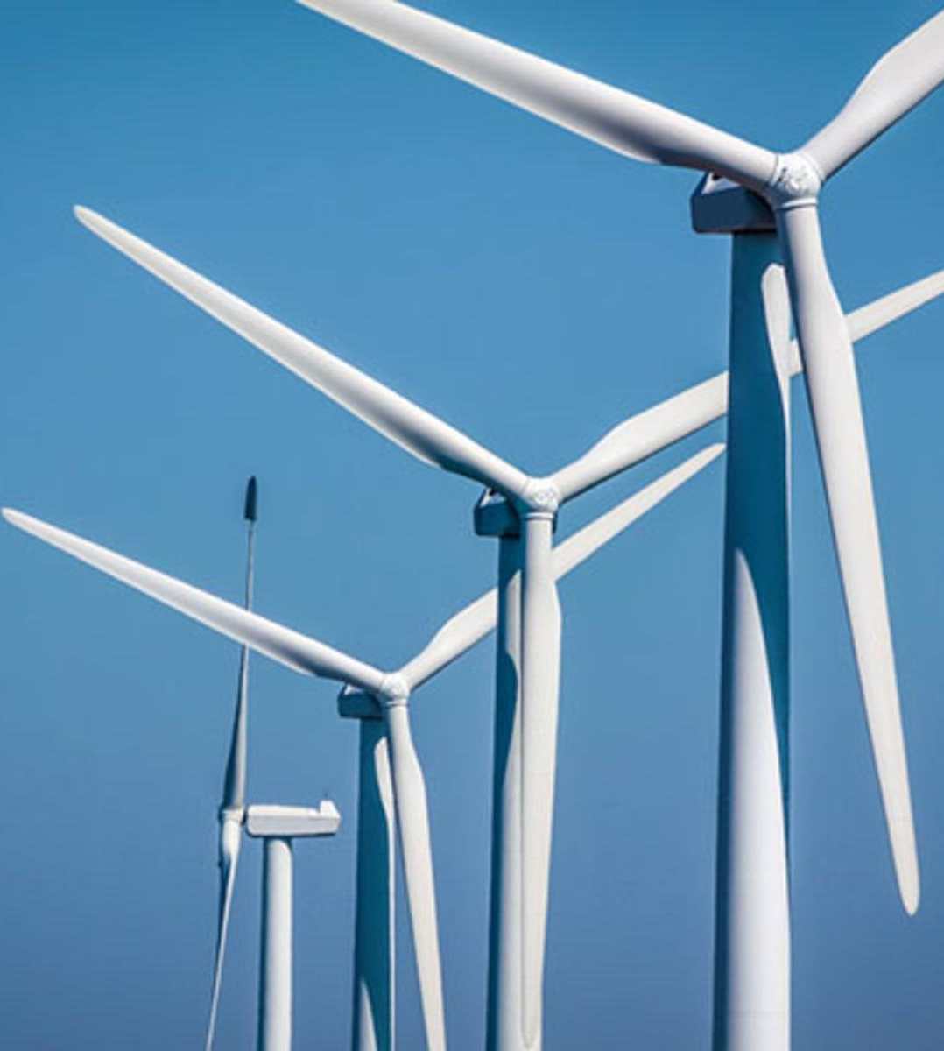

ATLANTIS
Snigdha Khanna Sourick Sinha
Salil Kumar Gaurav Paswan

Slide 2

Introduction
Wind Energy plays an increasing role in the supply of energy worldwide. Over the past 10 years, U.S wind power capacity has grown 15% per year and is now the largest source of renewable power. The wind energy industry is bringing billions in private investment, and tens of thousands of well-paying jobs, to rural and communities across the world – helping them attract business and pay for roads and schools.
Wind power is pollution-free, requiring no fuel but only the wind, which is also free.

Slide 3
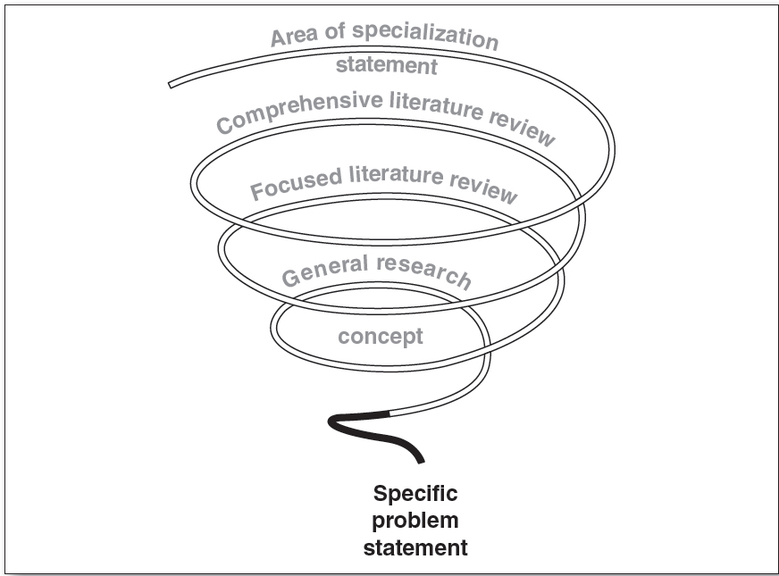
Problem Statement
The energy output of a wind farm is highly dependent on the wind conditions present at its site.
Our problem statement: To predict the energy output of wind turbine based on the climatic conditions and to develop an analytical Time Series forecast model for the same, finally building an application to suggest the best time to utilize the wind turbine taking parameters like wind speed and wind direction into consideration.

Slide 4

Proposed Solution
The proposed solution is to build a predictive model to calculate the effective instantaneous energy output, accounting for these factors, at any given point of time, so that the resources required for production (for example the fuel, manpower, maintenance) and overall cost of production can be reduced to a minimum.
Machine learning models being proposed here, are an instance of the realtime technology being put to use for the same.
Eurus SystemsTM deploys a user-friendly GUI, integrated with a backend ML based predictive model to predict active Power and forecast the parameter predictions for the upcoming months.

Slide 5

Novelty in Solution
Neural networks are generally used for discrete data prediction but using them for regression problems has given fruitful results in the past. They have, in fact, often outperformed traditional predictor models with much higher accuracy for the same dataset, just as it did for our own model.
Inclusion of more features aside from the ones provided in the reference dataset, based on our research.
Near accurate forecast of the daily, weekly, monthly and yearly forecasts based on Time Series Analysis so that Power output is maximum with minimum resource utilization.
Our intention has been to break the boundaries of existing solutions to come up with new ideas.

Slide 6

Business Aspect
The costs for a utility scale wind turbine range from about $1.3 million to $2.2 million per MW of nameplate capacity installed. In our model we are trying to predict the energy output with the help of an artificial neural network (ANN) which is commercially one of the best windmill integrated management systems.
Before taking a decision to install a windmill in a particular area, we can refer to our model which will predict the instantaneous Energy output of the windmill to be installed for a particular time frame and based on the prediction one can take a firm decision , whether it would be financially beneficial to install a windmill at that particular location and at that particular angle.

Slide 7

Business Aspect
Once the data teams have a better understanding of the actual data, they can use predictive modeling techniques, along with their business understanding, to forecast different business insights. These insights can later be used in website layout and marketing tactics to increase efficiency.
While working on this project we have been working with Big Data. By using large and complex sets of data, machine learning tools can develop their knowledge base and abilities on an ongoing basis which helps business to become smarter, savvier and more informed through automation thus a small change in the methodology can revolutionize an whole industry .

Slide 8
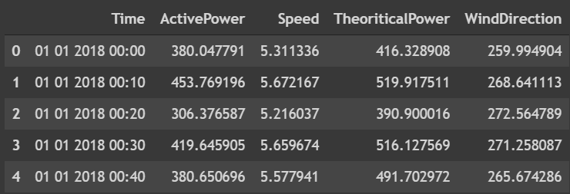
Dataset Gathering
In Wind Turbines, Scada Systems measure and save data like wind speed, wind direction, generated power etc. for 10 minutes intervals. This file was taken from a wind turbines scada system that is working and generating power in Turkey.
The data in the file is:
Date/Time: (for 10 minutes intervals)
LV Active Power (kW): The power generated by the turbine for that moment
Wind Speed (m/s): The wind speed at the hub height of the turbine (the wind speed that turbine use for electricity generation)
Theoretical Power Curve (KWh): The theoretical power values that the turbine generates with that wind speed which is given by the turbine manufacturer
Wind Direction (°): The wind direction at the hub height of the turbine (wind turbines turn to this direction automatically)
The following figure shows a snippet of our dataset

Slide 9

Methodology
We used Agile Methodology for our project.
Feature selection has been done from our datasets based on our background research. A good approach employs iterations among three stages: Data Collection/Reduction, Model Development, and Analysis and Variable Selection.
The output data: A singular value as instantaneous energy output for each corresponding row in the dataset.
Model Training: Different supervised learning models have been trained on the same dataset and the final model has been selected on the basis of their efficiency, hence enabling utilization of resources efficiently to reduce cost of production

Slide 10
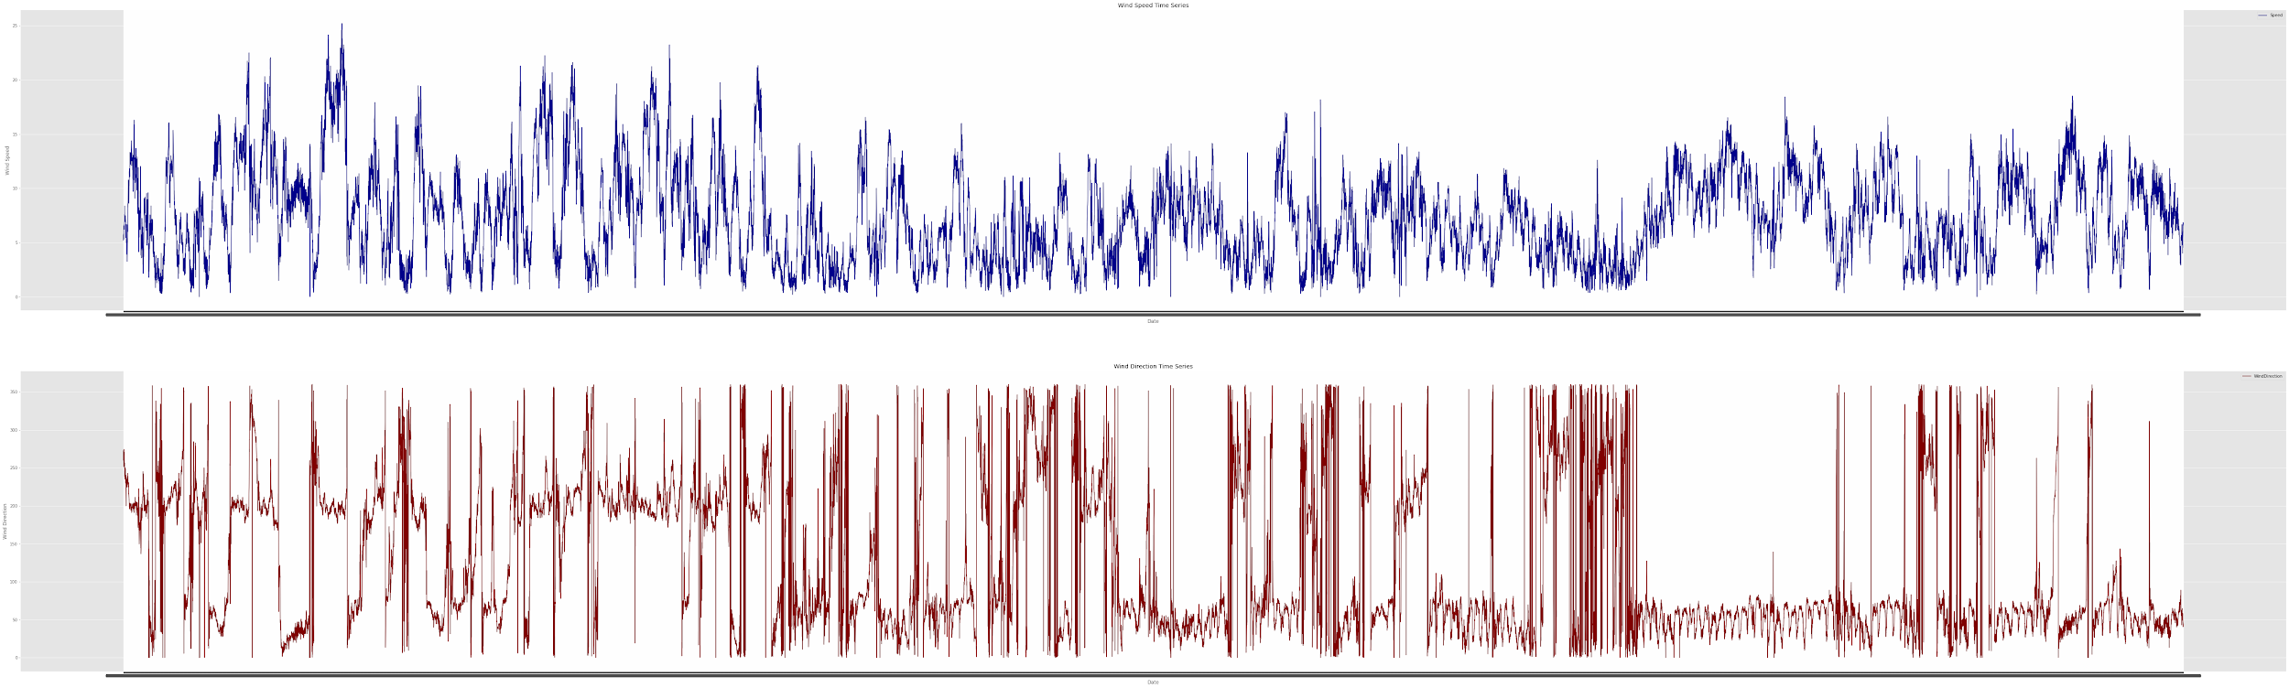
Time Series Analysis
Time Series Analysis has been done using Facebook Prophet(fbprophet). Prophet is a procedure for forecasting time series data based on an additive model where non-linear trends are fit with yearly, weekly, and daily seasonality, plus holiday effects. It works best with time series that have strong seasonal effects and several seasons of historical data.
In the following slides, time series forecasts for each parameter in the dataset have been shown with black dots from 2018-01 to about 2019-01.The dark blue plot across the graph shows the mean forecasted value for the corresponding parameter for the upcoming months
The following figure shows the Time Series Trend for the entire dataset
(Wind Speed trend is shown in Blue and Wind Direction trend is shown in Red)

Slide 11
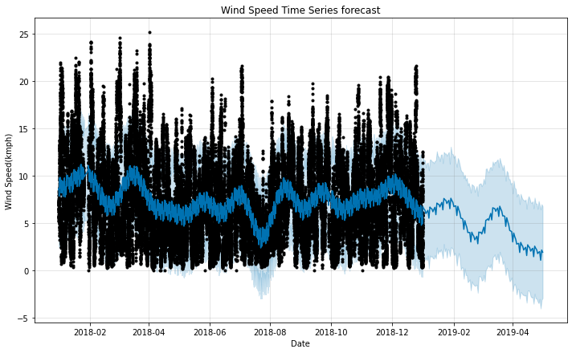
Time Series Analysis : Wind Speed
The overall forecast shows a steady value with occasional highs and lows. The dataset has been represented with the black dots shown in the plot with the dark blue line showing the forecasted values while the maximum variation possible is being represented by the light blue background. The model forecasts the wind direction from 2019-01 onwards. In recent years, we see that the forecasted value is highest for the month of February and March, 2019 whereas it hits an all time low of about 2 kmph around the month of May.
The following figure shows the Time Series Forecast for Wind Speed:

Slide 12
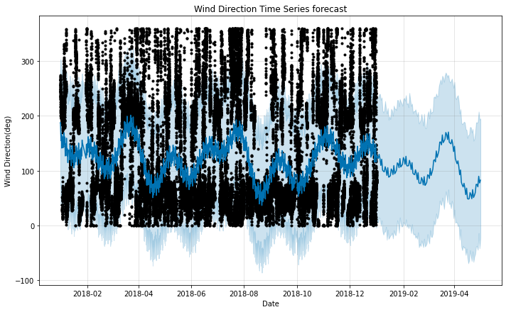
Time Series Analysis : Wind Direction
The overall forecast shows a steady value with occasional highs and lows. The data-set has been represented with the black dots shown in the plot with the dark blue line showing the forecasted values while the maximum variation possible is being represented by the light blue background. The model forecasts the wind direction from 2019-01 onwards. In recent years, we see that the forecasted value is highest for the month of March and April, 2019 whereas it hits an all time low of about 50 degrees around the month of May.
The following figure shows the Time Series Forecast for Wind Direction:

Slide 13
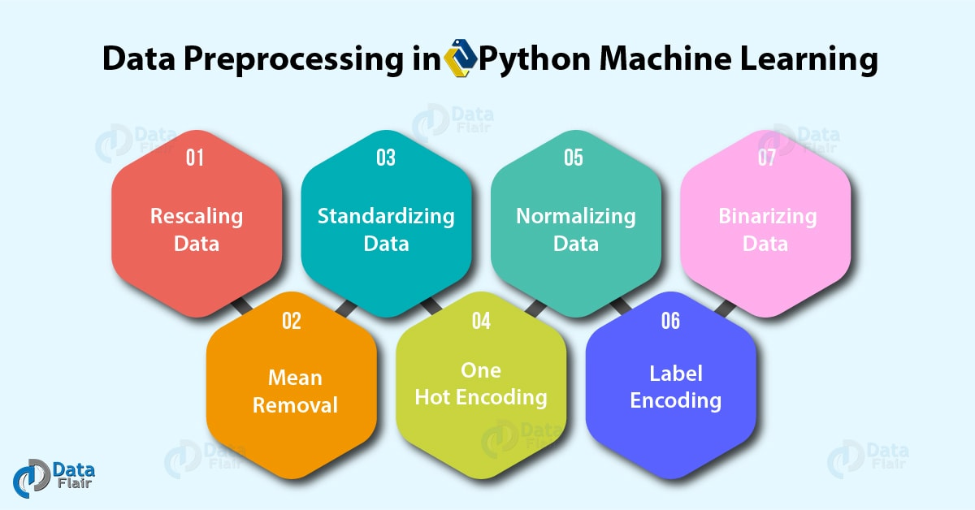
Data Processing
Data preprocessing in Machine Learning refers to the technique of preparing (cleaning and organizing) the raw data to make it suitable for a building and training Machine Learning models.
Various features were added in our dataset during the time of preprocessing using Pandas package in python for data analysis.
Techniques like Label encoding and Standardizing the data using MinMaxScaler were also used.
LSTM model required a numpy array as input for processing of data, so the dataframe was converted to numpy array for further processing.

Slide 14
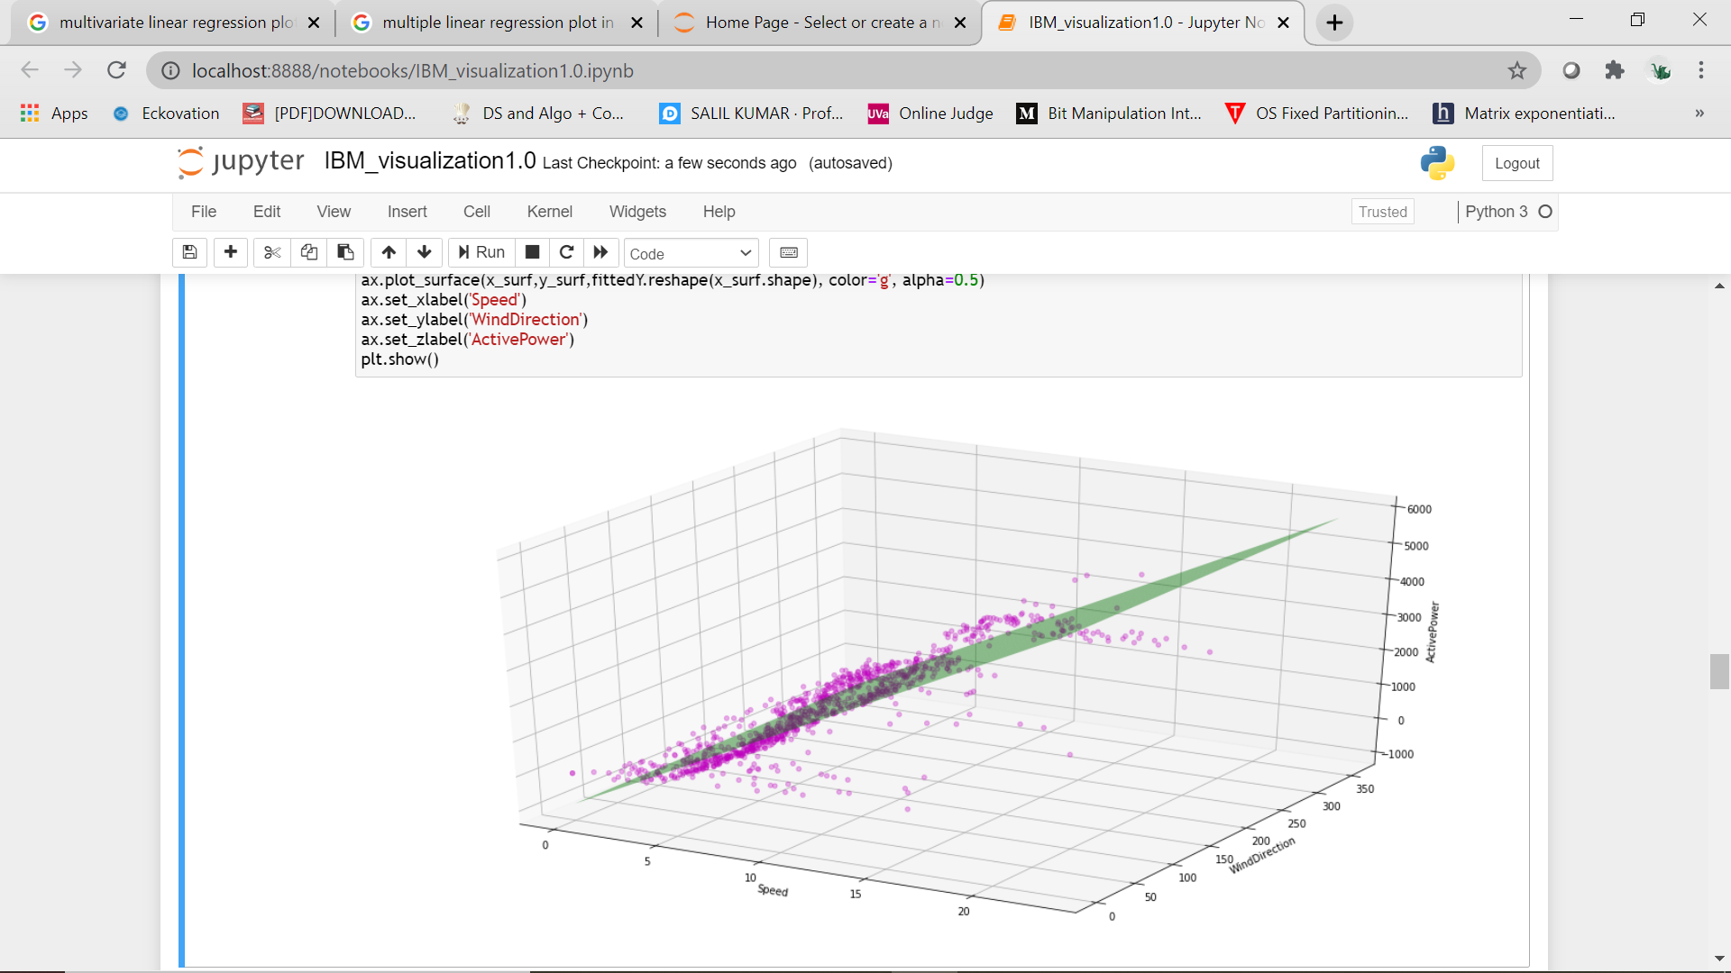
Model 1: Linear Regression
Multiple linear regression is an extension of simple linear regression. It is used when we want to predict the value of a variable based on the value of two or more variables. The variable we want to predict is called the dependent variable (or sometimes, the outcome, target or criterion variable).
For our model, the Regression plot plane was plotted as given alongside.

Slide 15
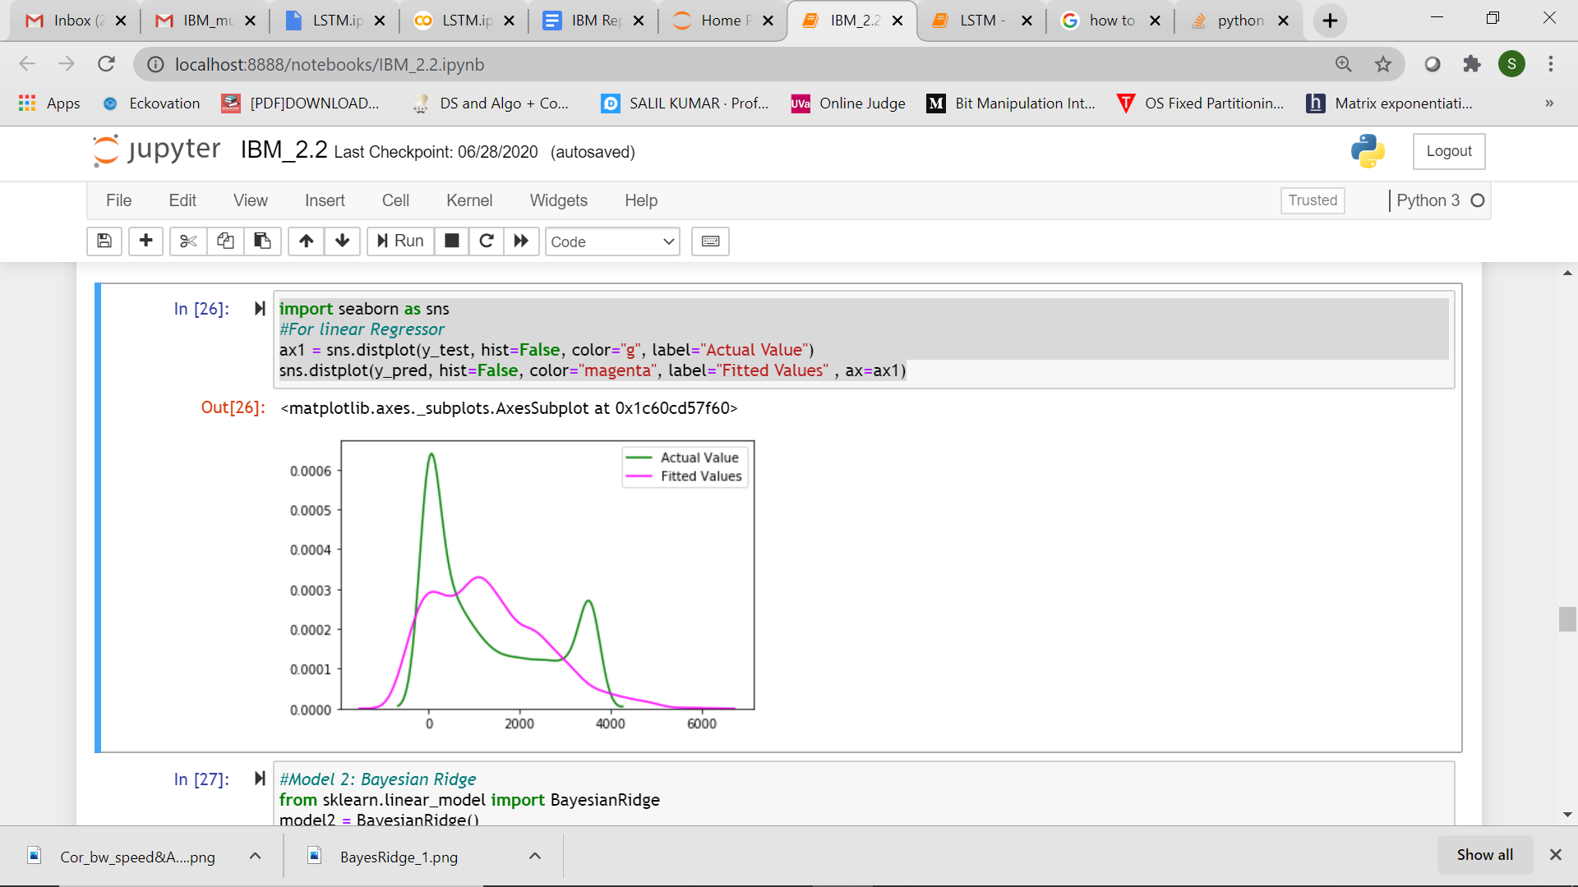
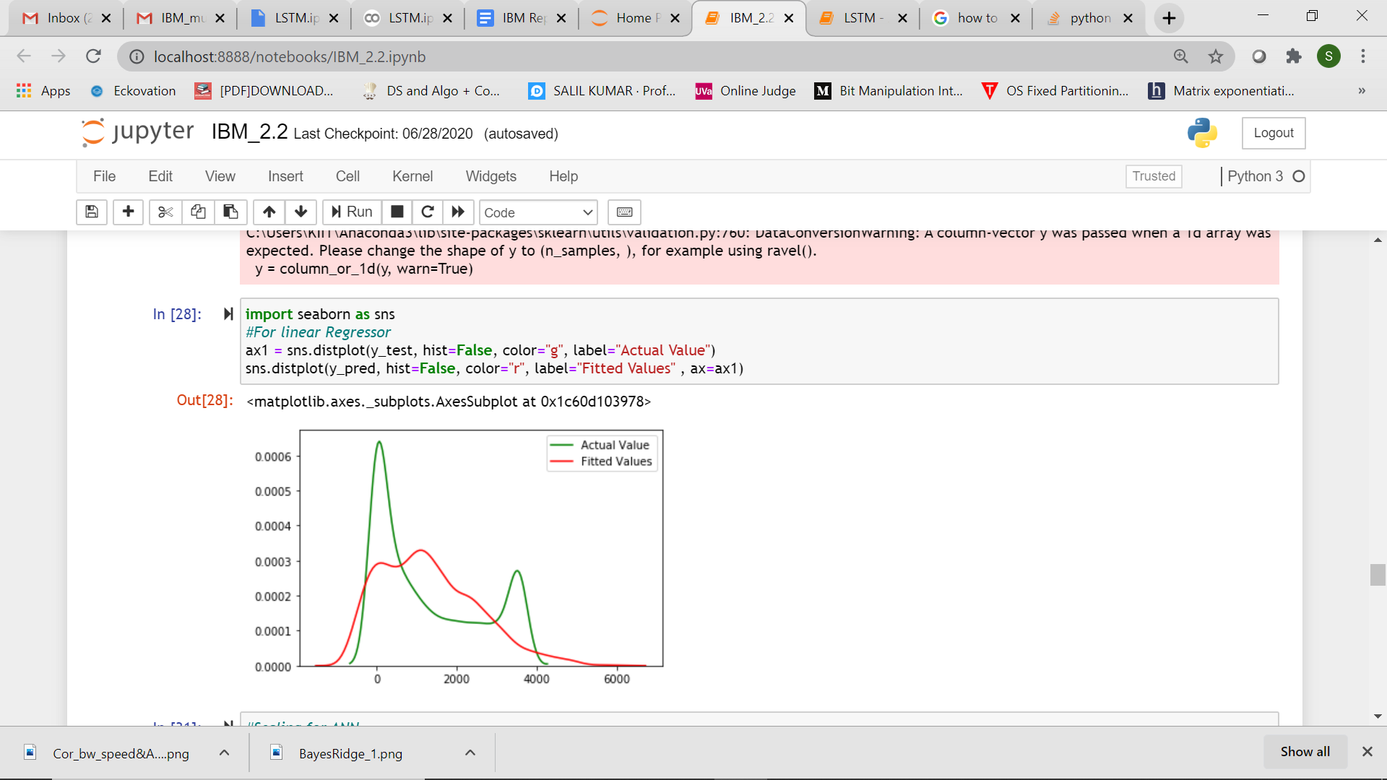
Model 2: Bayesian Ridge
Bayesian Ridge Regression is an approach to linear regression in which the statistical analysis is undertaken within the context of Bayesian inference. When the regression model has errors that have a normal distribution, and if a particular form of prior distribution is assumed, explicit results are available for the posterior probability distributions of the model's parameters.
Despite this, the Linear regression and Bayesian Ridge model performance on our dataset was pretty much the same, as can be seen alongside.
The top plot is for Linear Regression and one below is for Bayesian Ridge Regression

Slide 16
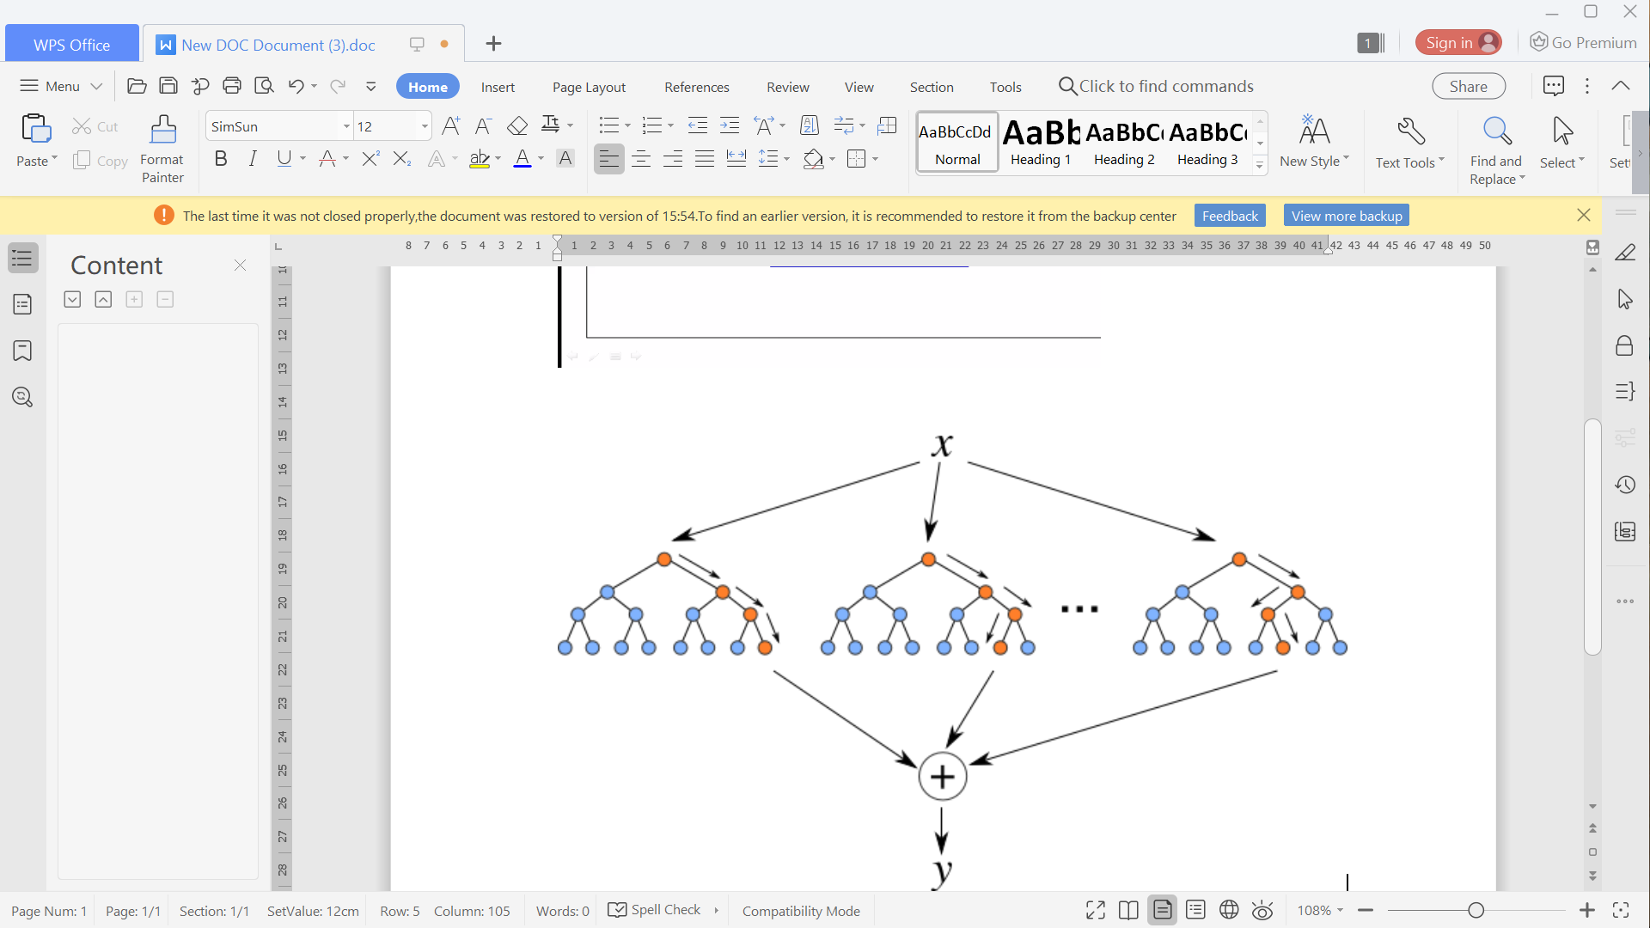
Model 3: Random Forest Regressor
The basic idea behind this is to combine multiple decision trees in determining the final output rather than relying on individual decision trees.
Random Forest has multiple decision trees as base learning models.
Random Forest model on our Scada dataset outperformed the models discussed in the previous slides.

Slide 17
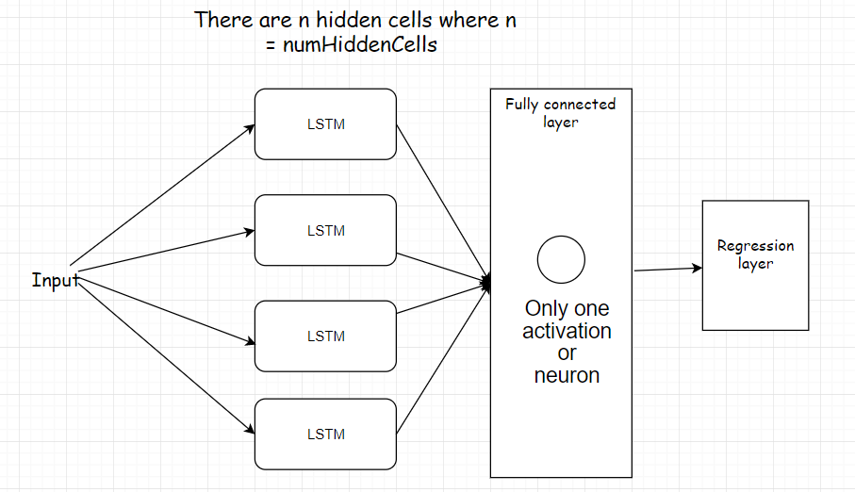
Model 4 : LSTM Neural Network
Long short-term memory (LSTM) is an artificial recurrent neural network (RNN) architecture used in the field of deep learning. LSTM networks are well-suited to classifying, processing and making predictions based on time series data, since there can be lags of unknown duration between important events in a time series.
Our decision to go for LSTM model was the result of referring various research papers.

Slide 18
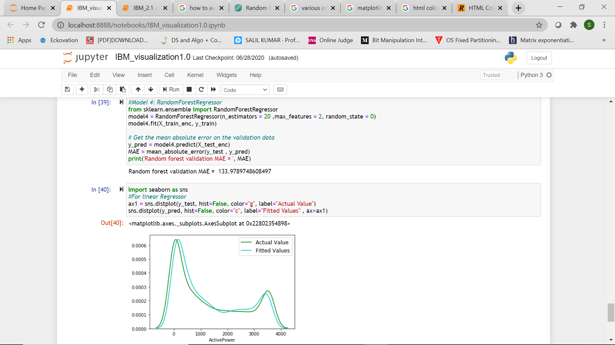
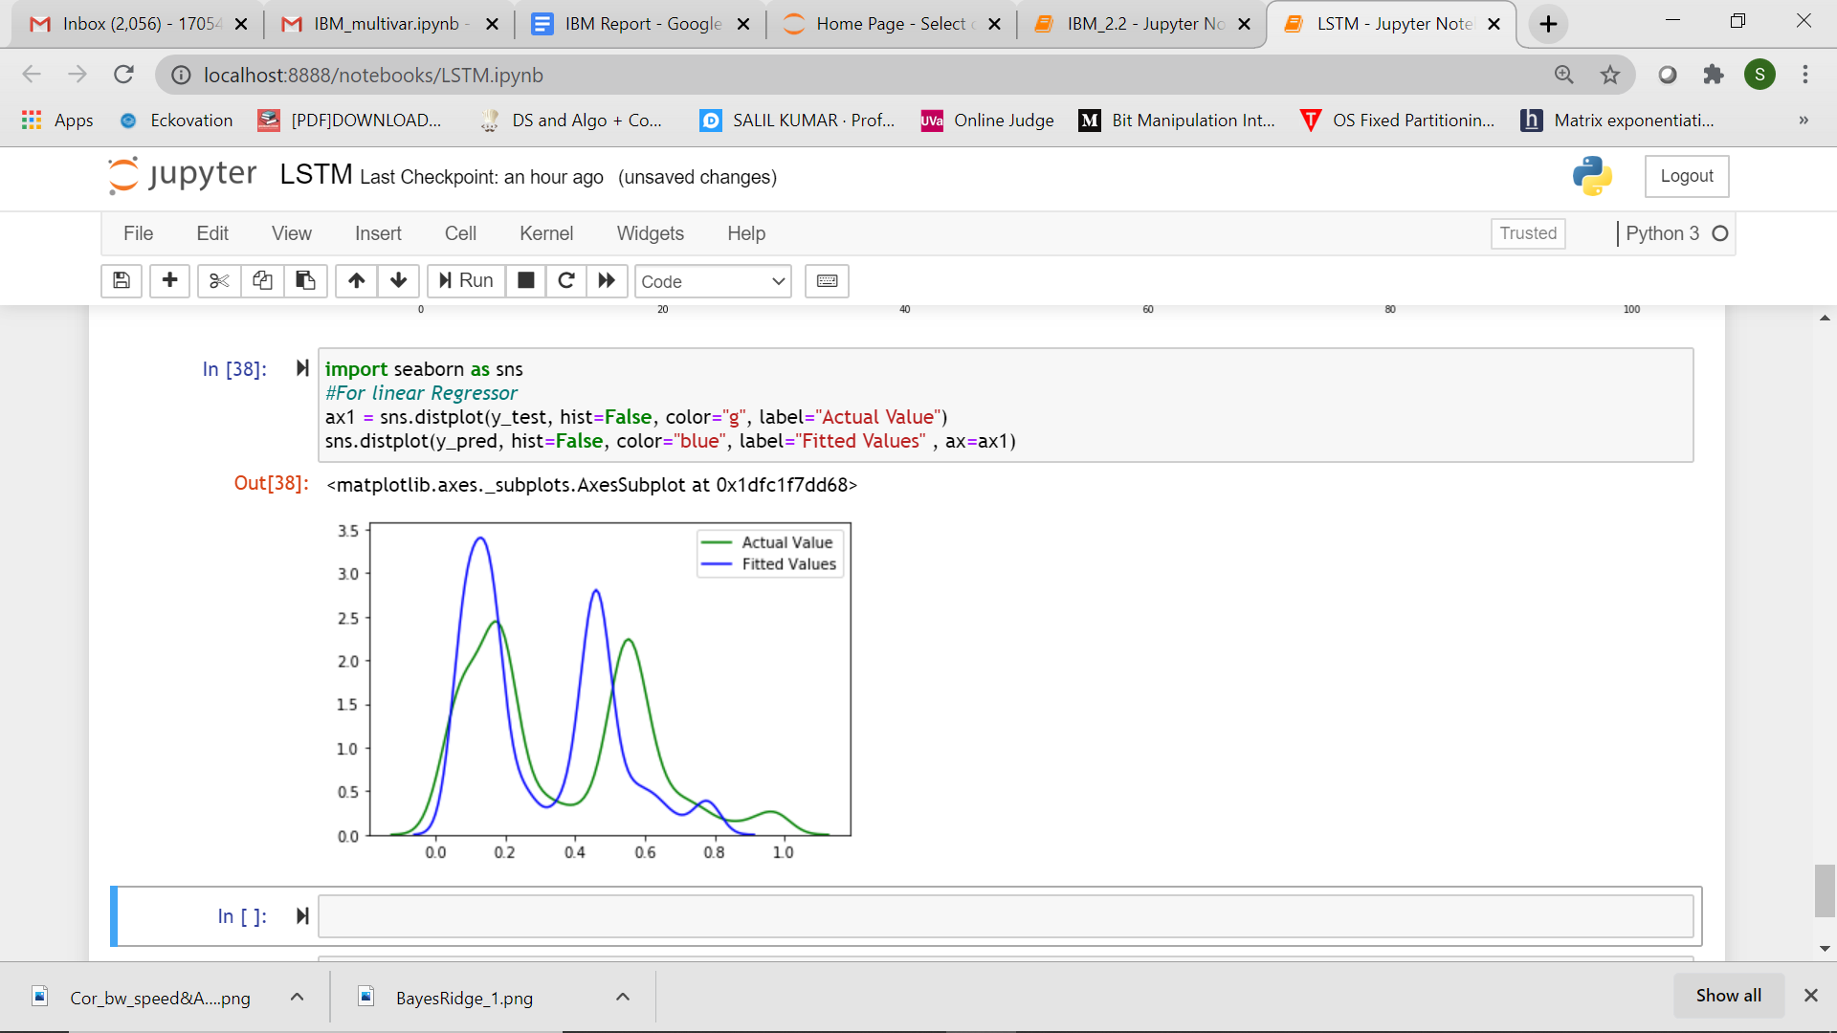
Testing: Validation and Accuracy
The training and testing of our models occurred with test size of 20% on actual dataset .
The MSE values for each models were calculated and graphs were plotted showing the performance of the models.
In statistics, the mean squared error (MSE) of an estimator (of a procedure for estimating an unobserved quantity) measures the average of the squares of the errors — that is, the average squared difference between the estimated values and what is estimated.
The top-right graph shows the comparison between Actual and predicted values based on Random Forest Model and the bottom one is for LSTM model.

Slide 19

Model Selection
Following was the accuracy score for each model so used:
We can see that our models give as a pretty good performance!
Despite LSTM outperforming all other models, we have deployed Random Forest as our base model for backend prediction as the LSTM model prediction is time consuming and hence, won’t be as user friendly.
.
MODEL | Linear Regression | Bayesian Ridge Regression | RandomForest | LSTM
ACCURACY(%) | 84 | 84 | 97 | -
MSE | 529.59 | 529.59 | 214.89 | 0.11827

Slide 20
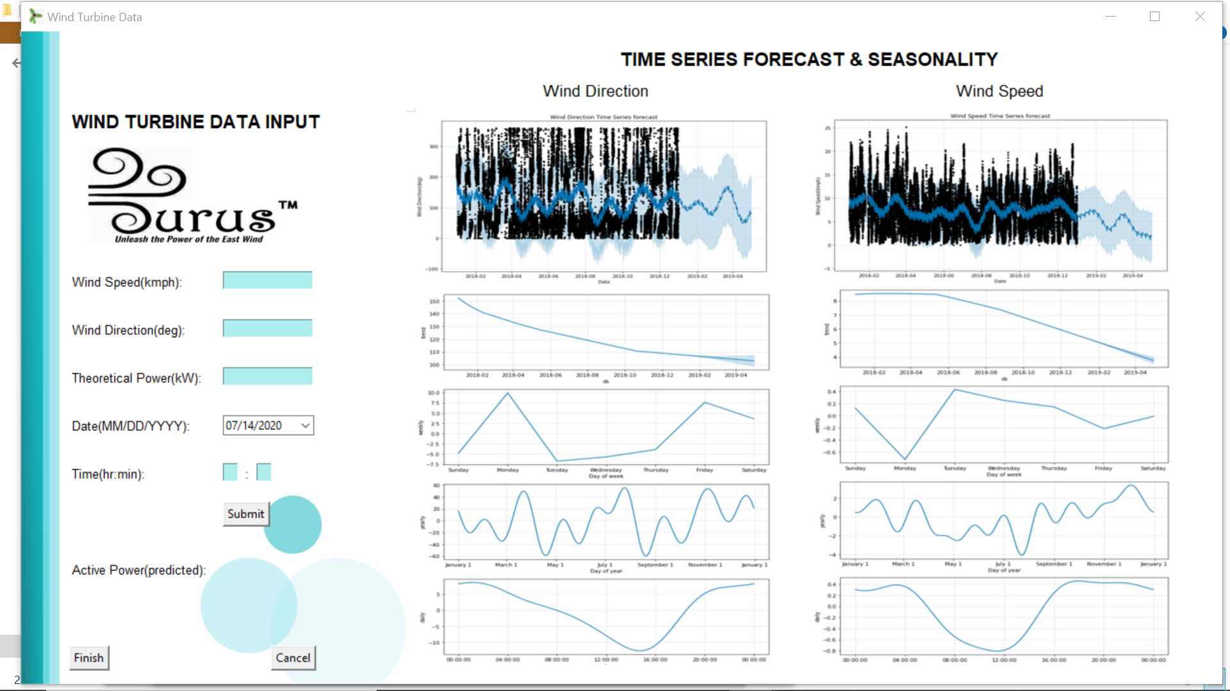
Graphical User Interface: GUI
Each and every response from the computer is visually communicated through GUI. A user with no computer knowledge can literally start learning about the machine through the GUI as it provides scope for users to explore and provides discoverability.
Tkinter is the standard GUI library for Python. Python when combined with Tkinter provides a fast and easy way to create GUI applications. Tkinter provides a powerful object-oriented interface to the Tk GUI toolkit.
Our tkinter application takes in input from the user and runs the machine learning model at its backend to predict and display the Active Power as the output.
A screenshot of our GUI as is alongside.

Slide 21

Conclusion
Eurus SystemsTM has the ability to efficiently do the following:
Our system makes near accurate forecasts for upcoming months after Time Series Analysis of the dataset.
It makes near accurate predictions for the Active Power that will be generated at any given time based on the Wind Speed and Wind Direction inputs
It makes use of a very user-friendly GUI
The backend ML models updates our dataset with each user input and its corresponding prediction.
Could we be any happier?

Slide 22

Future Scope
“If you aim higher than you expect, you could reach higher than you dreamed.”
~Richard Branson
To broadcast our application as an android application or website service to handle multiple user requests simultaneously.
Reducing the training time for LSTM neural network model and maintaining its accuracy so that it can be used for larger more complex datasets.
Our current dataset has been updated until 2018. We plan to incorporate data for the more recent years so that more current forecasts can be accurately done.

Slide 23

Teamwork
“The strength of the team is each individual member. The strength of each member is the team.”
~Phil Jackson
Team ATLANTIS is a quartet comprising Snigdha, Salil, Sourick and Gaurav.
This hackathon could not have achieved successful completion without adequate team efforts on behalf of each of them. Each of us made up for what another was lacking, making it a beautiful opportunity to collaborate and learn all along.
We will be ready for more!
Regards,
Team ATLANTIS

Slide 24



